Slide 1

Comparative Analysis of Service Costs in the Telecom Sector
The telecom industry is undergoing rapid change, driven by the increasing demand for digital communications and data usage. This report analyzes the service costs of key players in the Indian telecom sector, including Jio, Airtel, and Vodafone, examining their cost structures, pricing strategies, and innovation initiatives.

Slide 2


Methodology
This report provides a comprehensive analysis of how leading telecom firms structure their service costs, from large investments in networks to daily operational expenses. It aims to explain the company strategies that determine whether a firm will have high or low costs and how these are passed along to users.

Slide 3
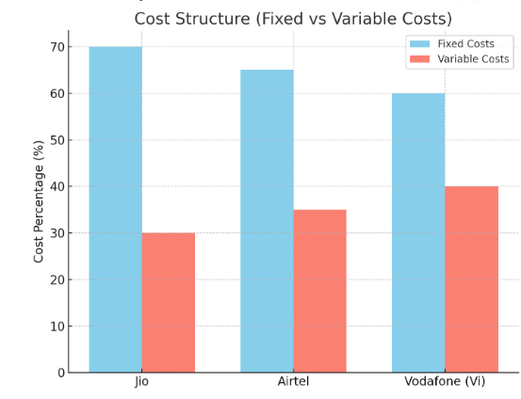
Cost Structure Analysis
Company
Fixed Costs (% of Total Costs)
Variable Costs (% of Total Costs)
Jio
70%
30%
Airtel
65%
35%
Vodafone
60%
40%
Telecom companies have high up-front capital outlays for infrastructure, which constitutes a significant portion of their fixed costs. Variable costs, such as customer service, marketing, and sales, fluctuate based on usage and demand.

Slide 4
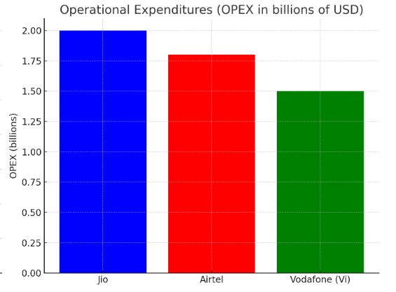
Operational Expenditures (OPEX)
1
Jio
2
Airtel
Jio has an OPEX of nearly $2 billion, indicating significant investment in maintaining and expanding its network and operations, including R&D.
Airtel's OPEX is slightly lower than Jio's, at approximately $1.8 billion, but still substantial. It also invests heavily in operations to maintain its competitiveness.
3
Vodafone
Vodafone has the lowest operational expenditures of the three, at approximately $1.5 billion. This suggests that Vodafone may be more cost-constrained in its operations.

Slide 5
Pricing Strategy Comparison
Jio
Airtel
Vodafone
Jio focuses on low-cost plans for the masses, hoping to attract a large customer base with its affordable pricing strategy.
Airtel offers a mix of midrange and premium plans, catering to both price-sensitive and quality-minded consumers.
Vodafone tends towards cheaper packages to capture price-sensitive customers, struggling to compete in the premium sector.

Slide 6
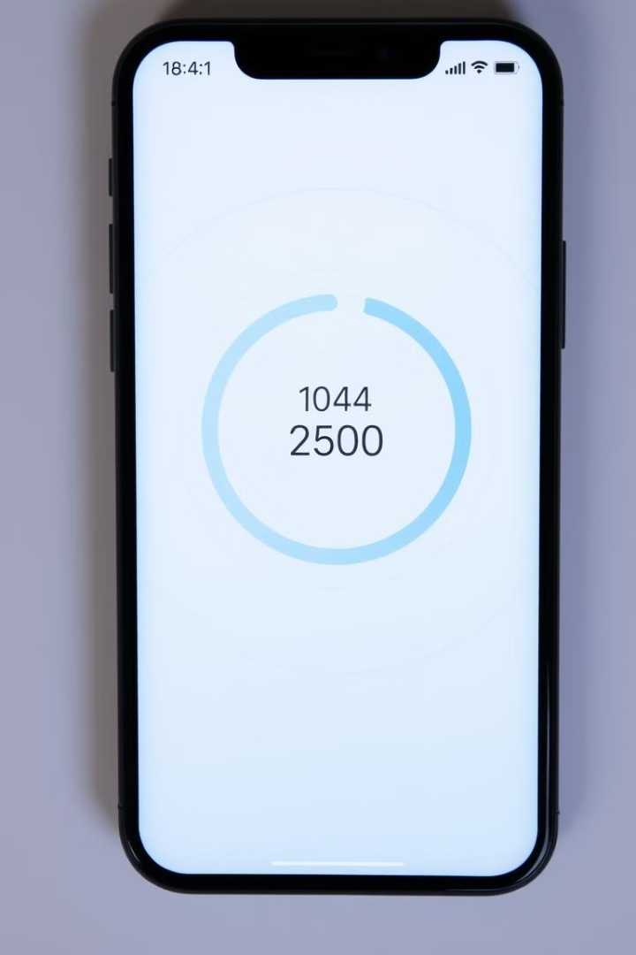
Usage-Based Costs
Usage Type
Jio
Airtel
Vodafone
Data (per GB)
₹4
₹4.5
₹5
Voice (per min)
₹0.50
₹0.60
₹0.55
Jio has set the benchmark for affordable pricing, attracting cost-sensitive high-end data users. Airtel focuses on high-quality service at a slightly higher price, while Vodafone aims to carve out a niche with flexible features and unique offerings.

Slide 7




Cost Drivers and Innovation
Jio
Jio is heavily investing in 5G and AI-driven customer support, aiming to be a leading provider of high-speed connections and a customer-centric experience.
Airtel
Airtel is focusing on IoT and cloud solutions, providing developer resources and developing homeworking apps for businesses and consumers.
Vodafone
Vodafone is taking a more cautious approach, but its focus on establishing its rural network is a significant strategic move.

Slide 8
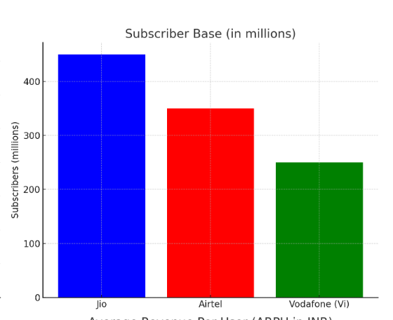
Subscriber Base
Jio
Airtel
Jio has over 450 million subscribers, significantly larger than its competitors. It is leveraging its large subscriber base to expand its internet services with a package of data and video on demand.
Airtel has around 350 million subscribers, making it the second largest telecom provider in India.
Vodafone
Vodafone has around 250 million subscribers, the smallest subscriber base among the three companies.

Slide 9

Regulatory and Compliance Costs
Company
License and Spectrum Fees (in billions)
Compliance Costs
Jio
$1 billion
High
Airtel
$0.9 billion
Medium
Vodafone
$0.6 billion
Low
The regulatory landscape is a major cost factor for telecom companies, with spectrum auctions, licensing fees, and data privacy laws all impacting their bottom line.

Slide 10
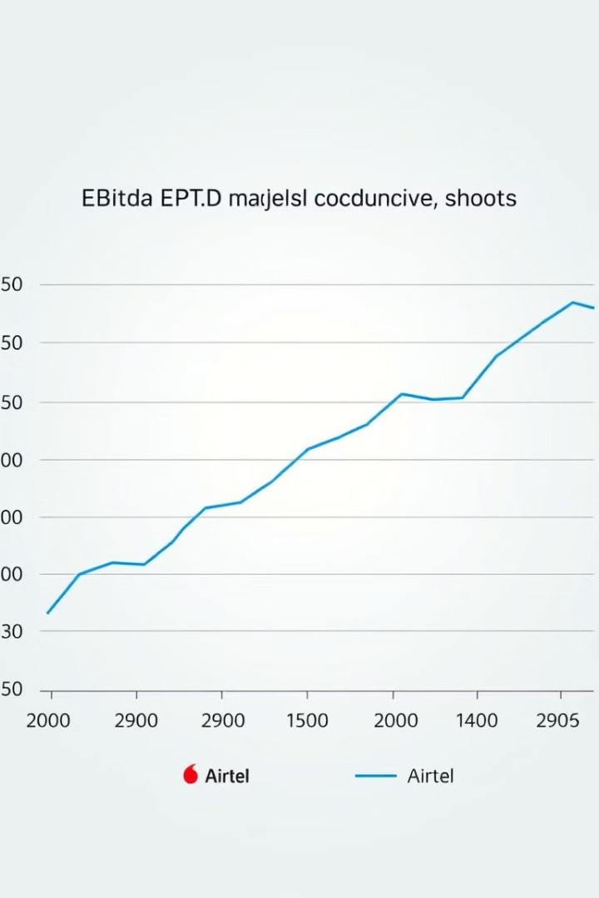


Financial Ratios and Profitability
ARPU
EBITDA Margins
Jio and Airtel have similar ARPU, ranging from ₹180 to ₹210, indicating they are able to earn more per customer. Vodafone has a lower ARPU of ₹125 to ₹150, suggesting it earns less per user.
Jio has the highest EBITDA margin at 42%, reflecting its strong profitability and efficient cost management. Airtel has a 39% margin, while Vodafone has the lowest at 28%.

Slide 11
Conclusion and Recommendations
The analysis of service costs among Jio, Airtel, and Vodafone reveals distinct financial strategies, operational efficiencies, and competitive positions. Jio leads with a large subscriber base, affordable pricing, and significant investments in 5G and AI, but faces challenges in managing fixed costs and regulatory compliance. Airtel maintains a strong position with balanced plans, robust ARPU, and strategic bets on IoT and cloud platforms, but also faces regulatory expenses. Vodafone has the lowest operational outlays but struggles with a smaller customer base, lower ARPU, and intense competition in the premium segment.
Recommendations include: Jio should continue leveraging technology to improve customer experience and operational efficiency while exploring cost reduction strategies. Airtel should maintain balance in its plans while ensuring high service quality and investing further in emerging technologies. Vodafone should focus on increasing market share through unique attributes and flexible pricing strategies, addressing competitive challenges in the data segment by offering content and services to attract high-end users. All companies should prioritize technology integration, customer-centric approaches, and operational efficiency to navigate the complex telecom landscape.

Slide 12
Thank You

